Slide 1
Goal 1
To what degree can we detect (count) animals with object detection based on a small training/test dataset
This will give us valuable information for next steps
Correct annotations of animals for train/test
Goal 2
To what degree can we classify different species OR classify individual species into relevant classes with object detection
Correct annotations of animals for train/test with classes
Goal 3
?

Slide 2
Any method we develop requires annotated reference data for testing.

Slide 3
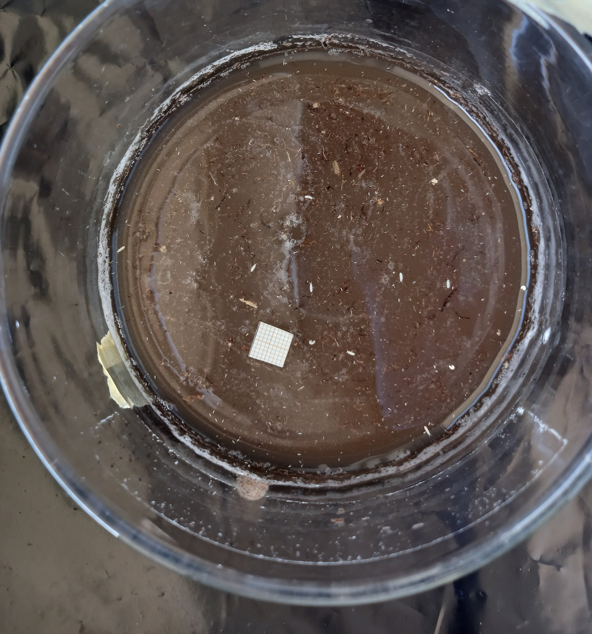

Slide 5
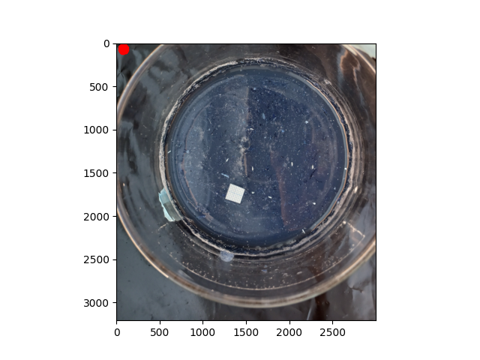

Slide 6
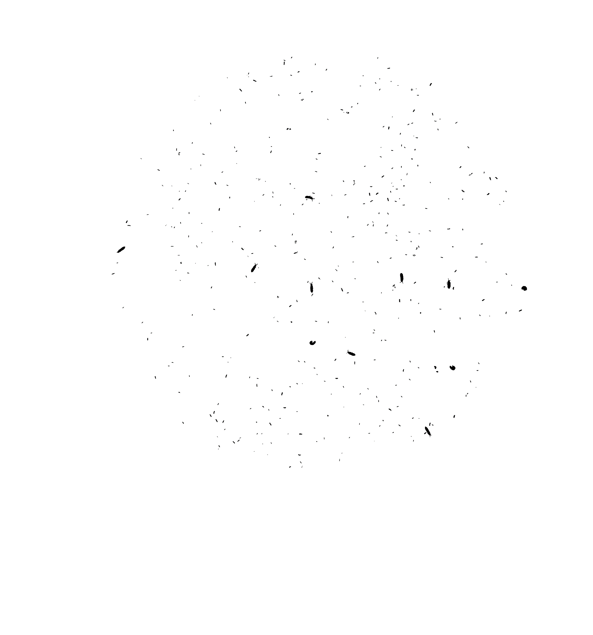

Slide 7
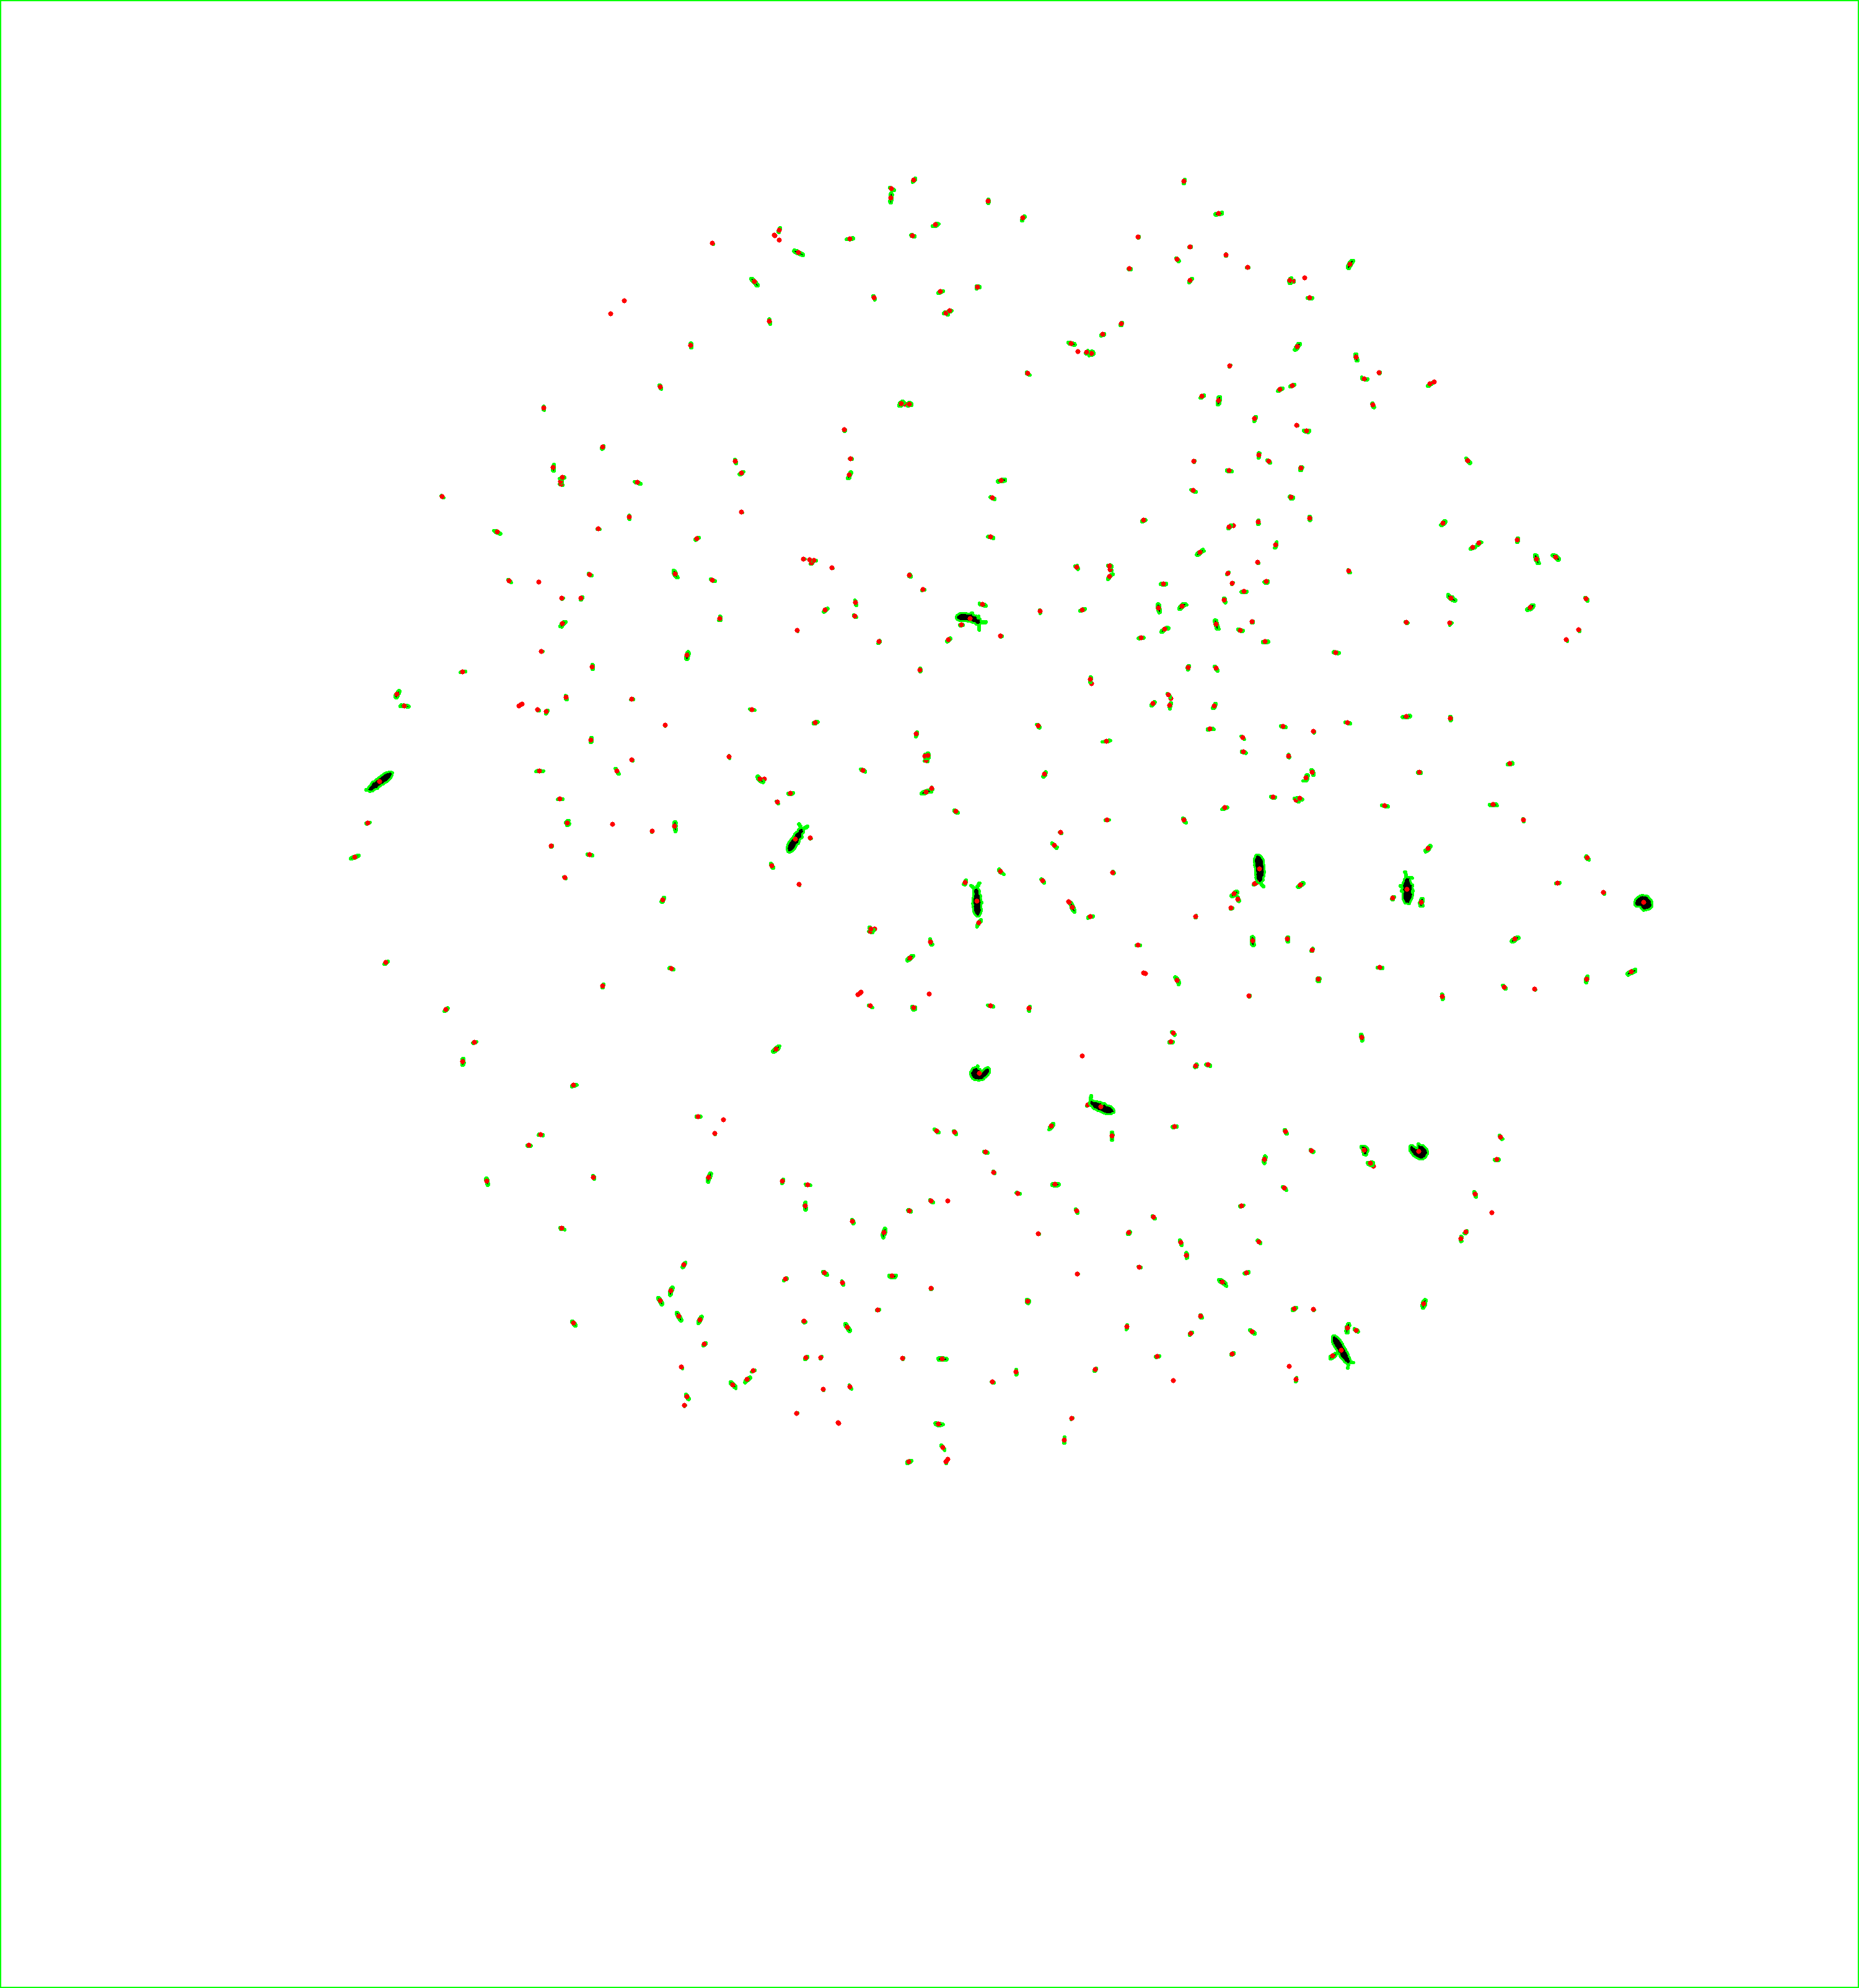

Slide 9
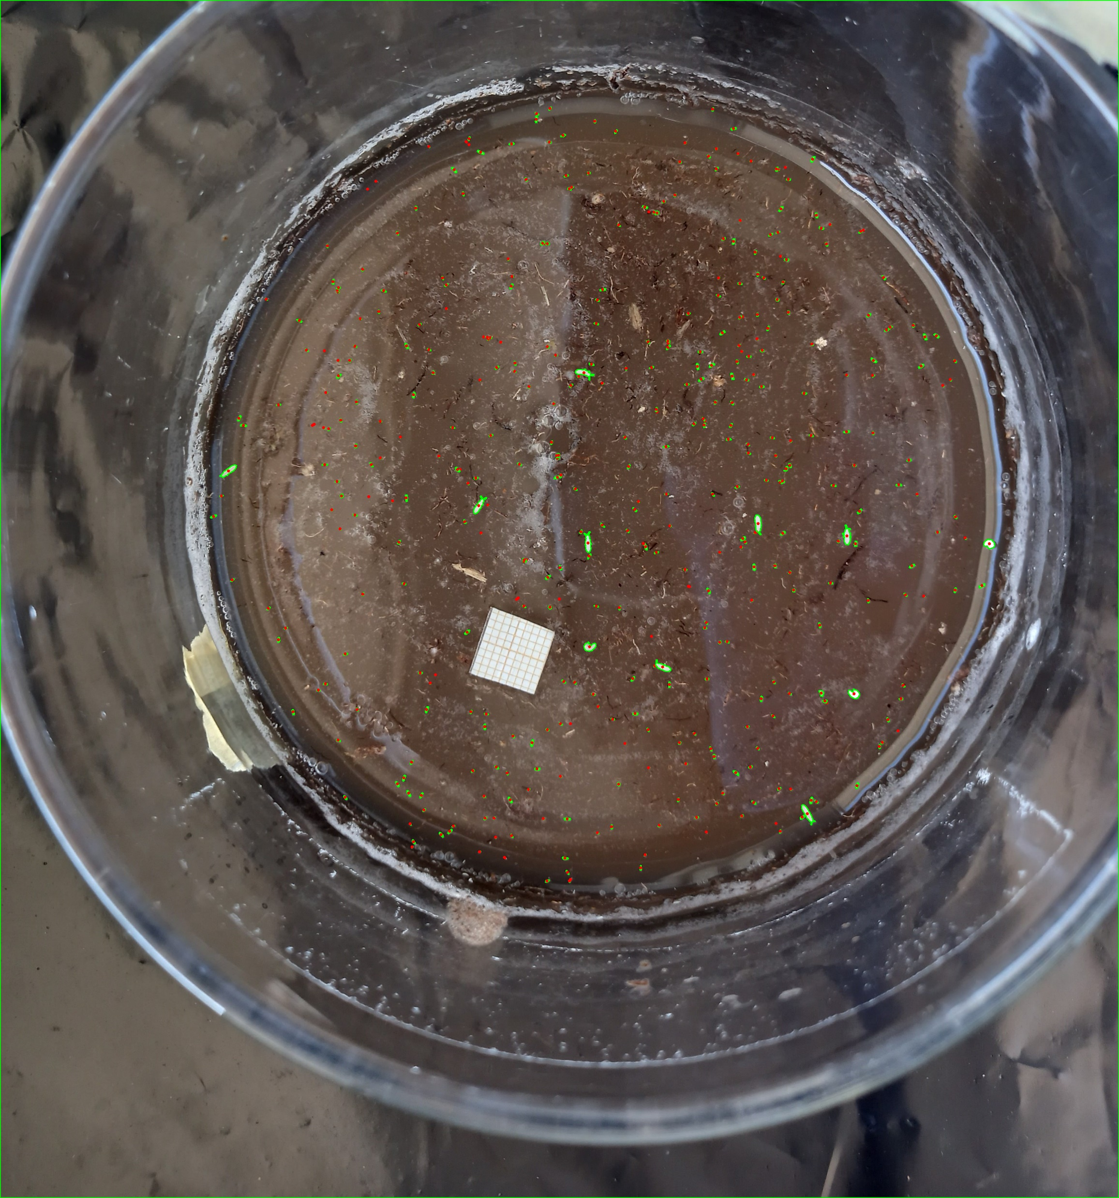

Slide 10
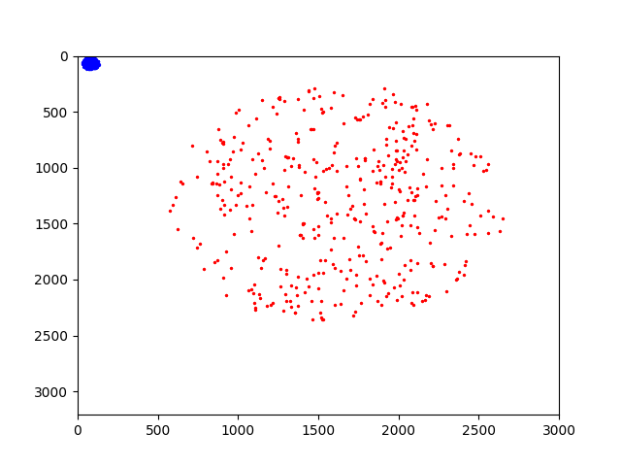
Contour centroids
Coordinates in dataset

Slide 11


Slide 12
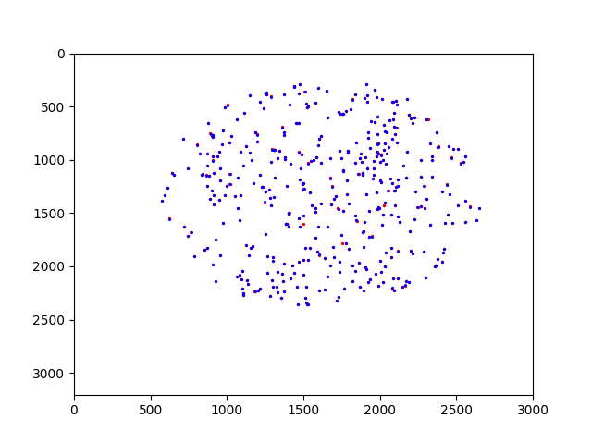
Factor: 20.124

Slide 13

If information here is valuable (e.g. classes can be extracted), we use the derived factor to convert coordinates.
If not, we can generate bounding boxes directly from contours.

Slide 14


Automatically generated bounding boxes

Slide 15
Does the original data contain any valuable information?
How many similar dataset available?
How much variation in images?
How much variation in scaling factor?

Slide 16
Goal 1
To what degree can we detect (count) animals with object detection based on a small training/test dataset
This will give us valuable information for next steps
Correct annotations of animals for train/test
A number of fully annotated plates (depending on variation in images)
Goal 2
To what degree can we classify different species OR classify individual species into relevant classes with object detection
Correct annotations of animals for train/test with classes
Goal 3
?

